Slide 1
Batch Scripting
Student: Zorica Nikoloska
Professor: Daniela Meckaroska

Slide 2
Batch Scripting Definition
Batch scripting is the process of writing a series of commands in a plain text file with the .bat or .cmd extension, which is executed by the Windows Command Line Interpreter (cmd.exe).
The term "batch" refers to the idea of grouping commands together to run in a sequence, automatically.
A batch script can automate repetitive tasks such as file backups, system cleanup, user management, software installations, and running diagnostic tools.
It reduces human intervention by executing multiple commands with a single file.

Slide 3
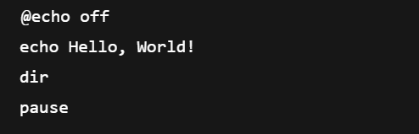
This script prints a message, lists files in the directory, and waits for user input before closing.

Slide 4
Why is Batch Scripting Used?
Batch scripting is used for various reasons:
Automation: Saves time by running multiple commands in sequence.
System Administration: Simplifies routine tasks like disk cleanup, network configuration, and user management.
Software Deployment: Helps in installing or configuring applications automatically across multiple systems.
Task Scheduling: Works well with Windows Task Scheduler to run scripts at specific times or events.
Troubleshooting: Scripts can collect logs or run diagnostics repeatedly and consistently.
Benefits:
No additional software required (comes with Windows).
Simple syntax for basic tasks.
Easy to learn and edit.
Great for beginners and sysadmins.

Slide 5
Different Types of Batch Scripting
There are no formal "types" of batch scripting like in programming paradigms, but batch scripts can be categorized based on purpose or target use-case:
a. Startup Scripts
Run during system boot.
Often used to mount drives or set environment variables.
b. Login Scripts
Run when a user logs in.
Used to map network drives, launch apps, or set user-specific settings.

Slide 6
Different Types of Batch Scripting
There are no formal "types" of batch scripting like in programming paradigms, but batch scripts can be categorized based on purpose or target use-case:
c. Maintenance Scripts
Perform periodic cleanup, backups, updates, etc.
d. Installation Scripts
Install or configure software silently using command-line options.
e. Monitoring Scripts
Check system status or log system performance over time.

Slide 7
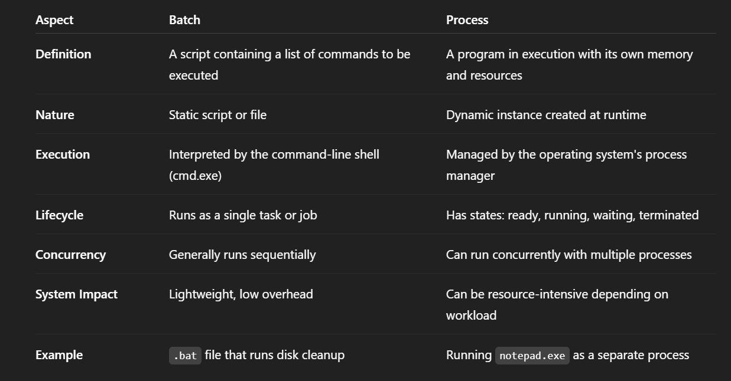
Differences Between Batch and Process

Slide 8
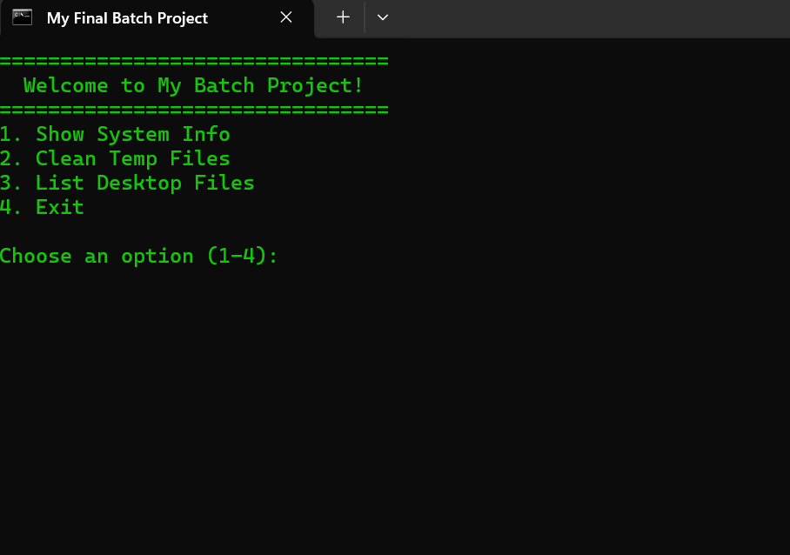
System Maintenance Toolkit
@echo off
title My Final Batch Project
color 0A //This comand will turn the letters green
:menu
cls
echo ================================
echo Welcome to My Batch Project!
echo ================================
echo 1. Show System Info
echo 2. Clean Temp Files
echo 3. List Desktop Files
echo 4. Exit
echo.
set /p choice=Choose an option (1-4):
Cleans up output, so only our custom messages show.

Slide 9
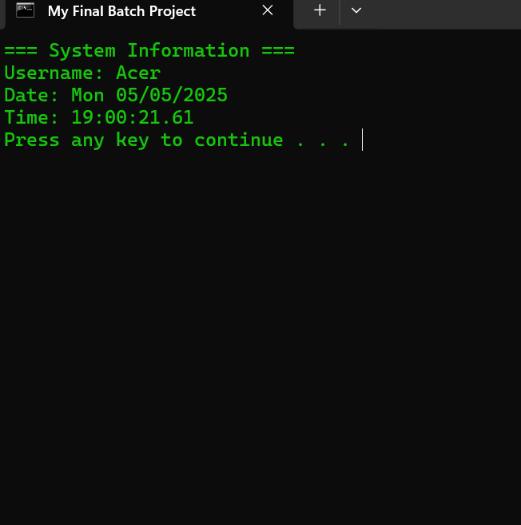
System Maintenance Toolkit
if "%choice%"=="1" goto sysinfo
if "%choice%"=="2" goto cleantemp
if "%choice%"=="3" goto listdesktop
if "%choice%"=="4" goto end
goto menu
:sysinfo
cls
echo === System Information ===
echo Username: %username%
echo Date: %date%
echo Time: %time%
pause
goto menu
Checks what the user typed and sends them to the correct section using goto.
If they enter something invalid, it goes back to the menu.
Displays username, date and time, pause means that it waits for a user to press any key,
goto menu means going back to the menu.

Slide 10
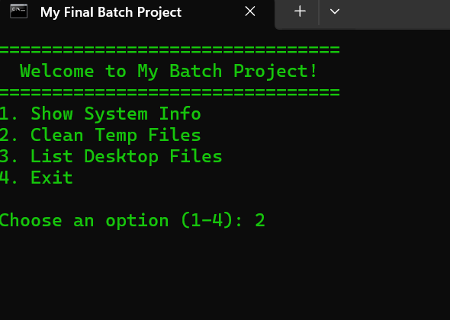
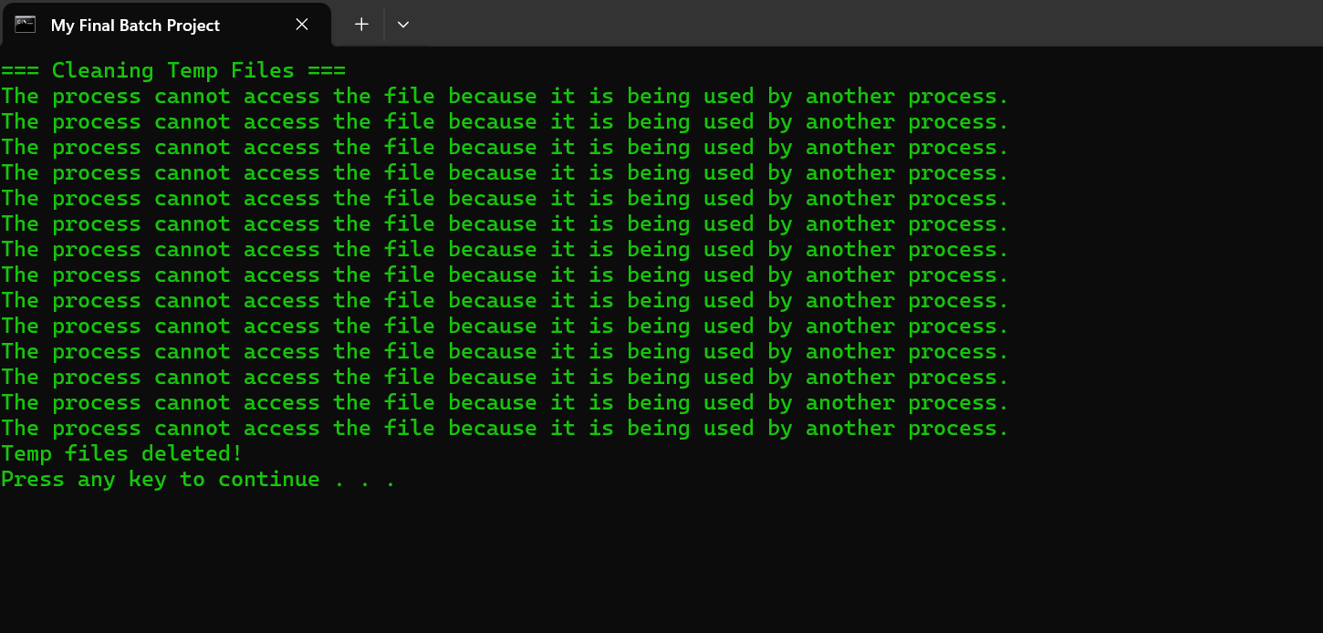
System Maintenance Toolkit
:cleantemp
cls
echo === Cleaning Temp Files ===
del /q %temp%\*.* > nul
echo Temp files deleted!
pause
goto menu
:listdesktop
cls
echo === Files on Your Desktop ===
dir "%userprofile%\Desktop"
pause
goto menu
:end
cls
echo All done!
pause
exit
Cleans up temp files stored in the %temp% file.
nul hides output; /q makes deletion quiet.
After deletion, it pauses and returns back to menu

Slide 11
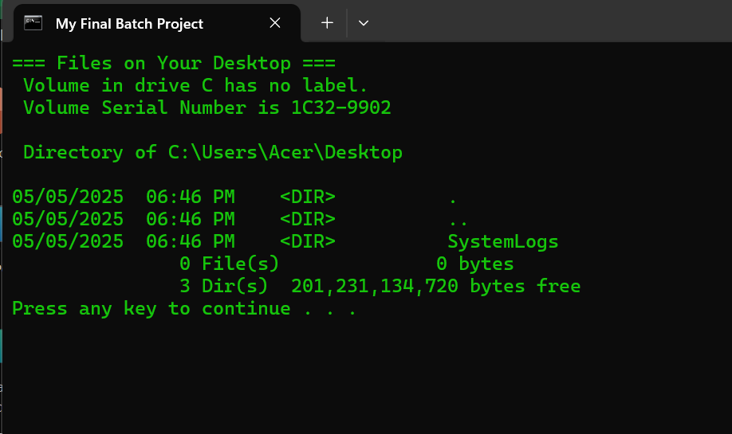
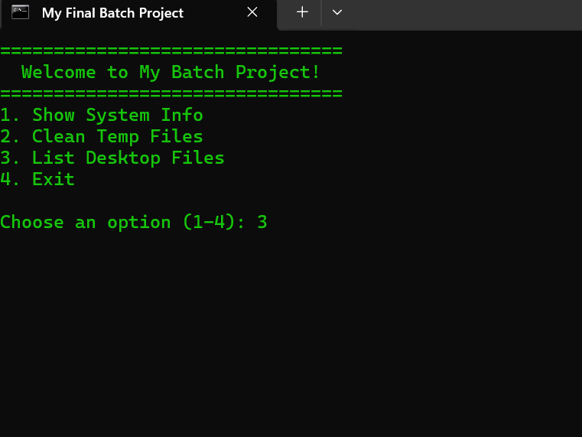
System Maintenance Toolkit

Slide 12
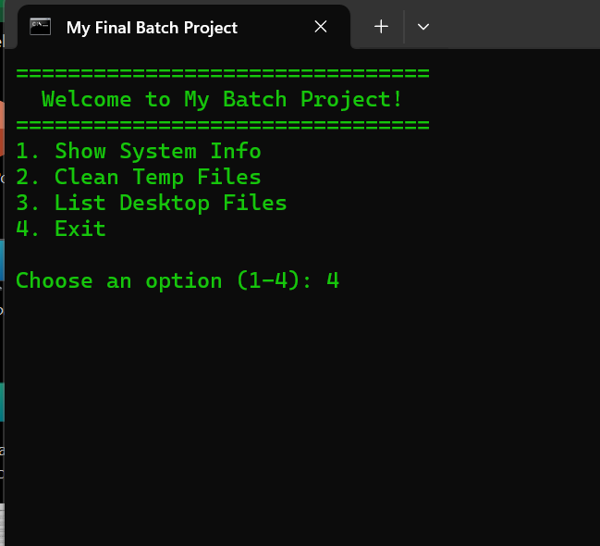
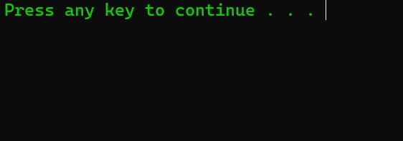
System Maintenance Toolkit

Slide 13
References
https://www.geeksforgeeks.org/basics-of-batch-scripting/

Slide 14
Thank you for your attention!

